Slide 1
CSC428 P2 Prototype
Azadeh Assadi,Vijay bala, GuanZhong Ding

Slide 2
This powerpoint will present a quick walkthrough of our prototype. We keep most of the functionalities of the original application with the introduction of a few new features. (Please note that details might not be portrayed perfectly in presentation as it is only a prototype)

Slide 3
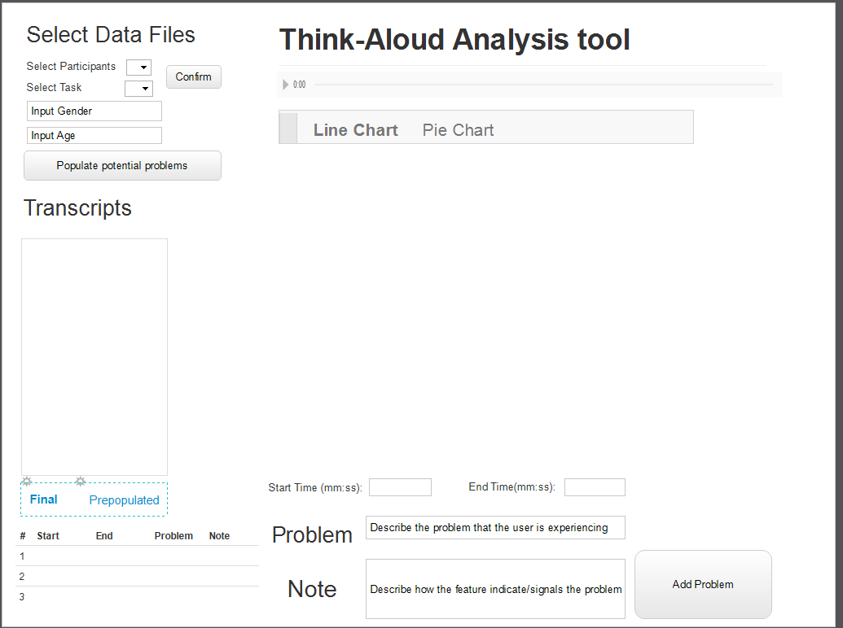
This is the index page of our application, a new feature is added which is the input of gender and age of the participant (ie. the recorded interview). Gender and age are important factors which affect the pitch of a person. Those two values will affect later analysis of the pitch.

Slide 4
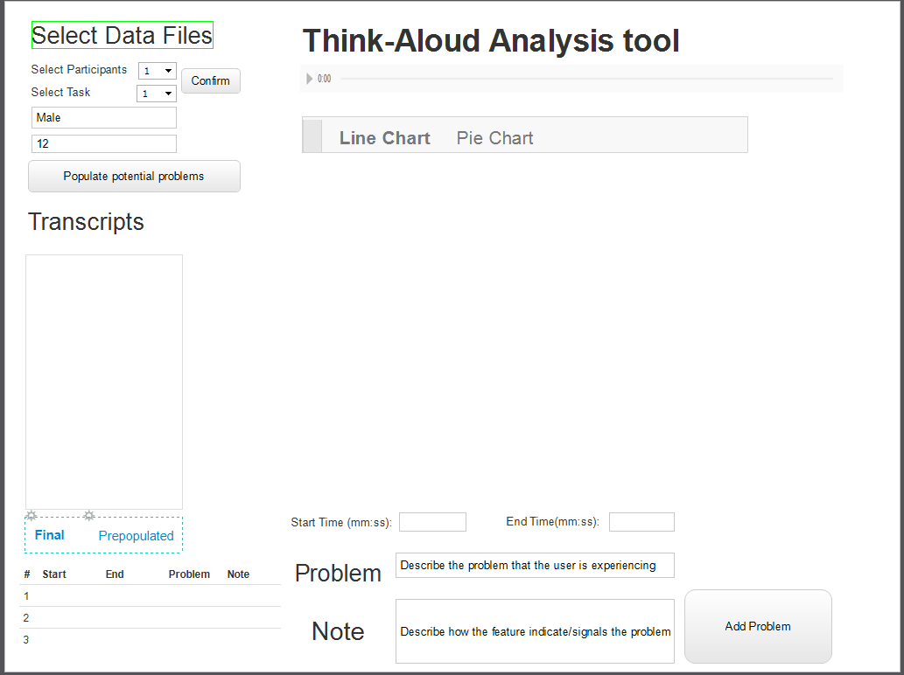
Once the demographics (i.e. participant, task, gender and age) of the participant are entered, by clicking confirm, the user can move to the next phase

Slide 5
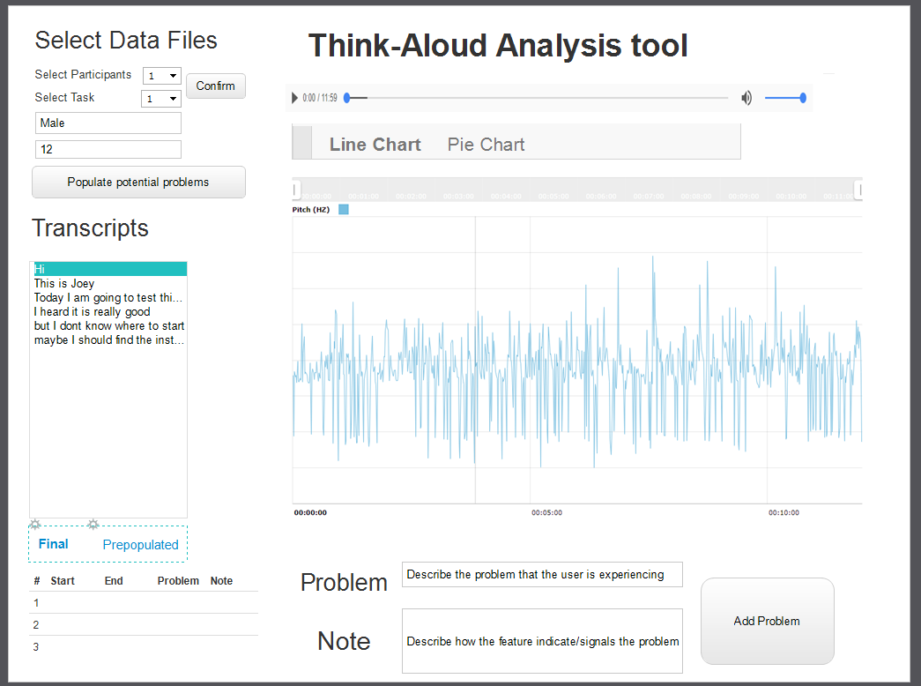
One of our major objectives was to automatically populate the potential problems for the users to make the process of problem identification in qualitative research more efficient. To do so, we utilize the transcribed text in conjunction with an algorithm to analyze the pitch of the speaker/participant in the background to achieve our objective.
The “Final” state here indicates that no problems were identified.

Slide 6
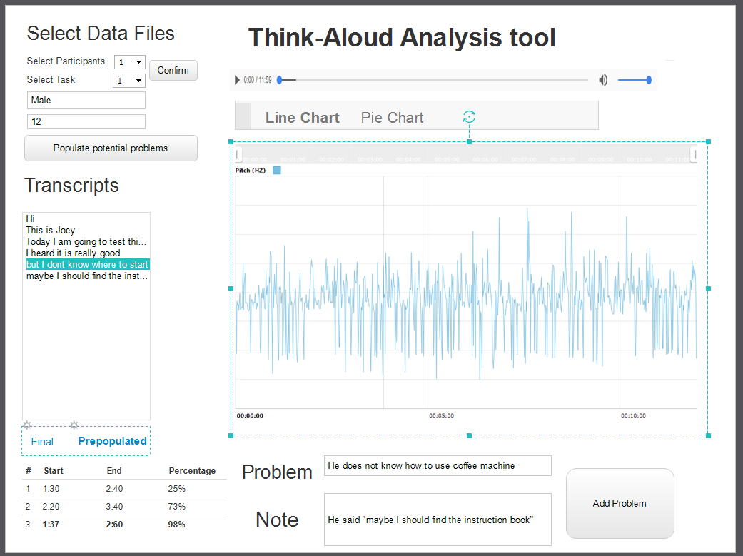
By clicking “populate potential problems” the application will now utilize our algorithm to identify any potential problems based on the participant/speaker’s pitch. These potential problems are marked in the “prepopulated” section of the transcripts. The user can now review the suggestions manually and determine their validity.
If a user agrees on the problem then he can add this problem to the final state
We also provide the users with a Percentage accuracy of our analysis which reflects the algorithm’s confidence in identifying the potential problem.

Slide 7
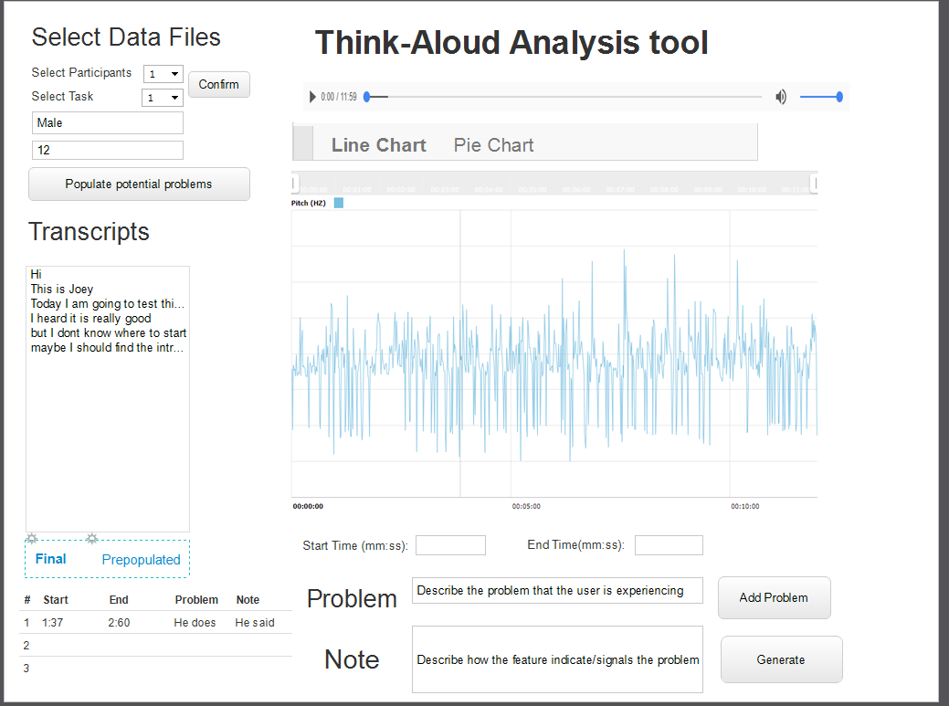
Users still have the freedom to identify problems themselves and add it to the final state. After hitting generate, the result will be stored in a json file.
Switching back to the final state, we can see the problem we added from the prepopulated section is already saved.

Slide 8
Some more functions
The functions introduced this far are our “must have” functions for this application. Time permitting, we will try to implement two more functions which are more challenging given the time constraint. First is a pie chart to better navigate between the various sections of the recording (taking into account the identified problems)(Slide 9). Second is color coding the line chart based on the frequency of the recording/speech (Slide 10).

Slide 9
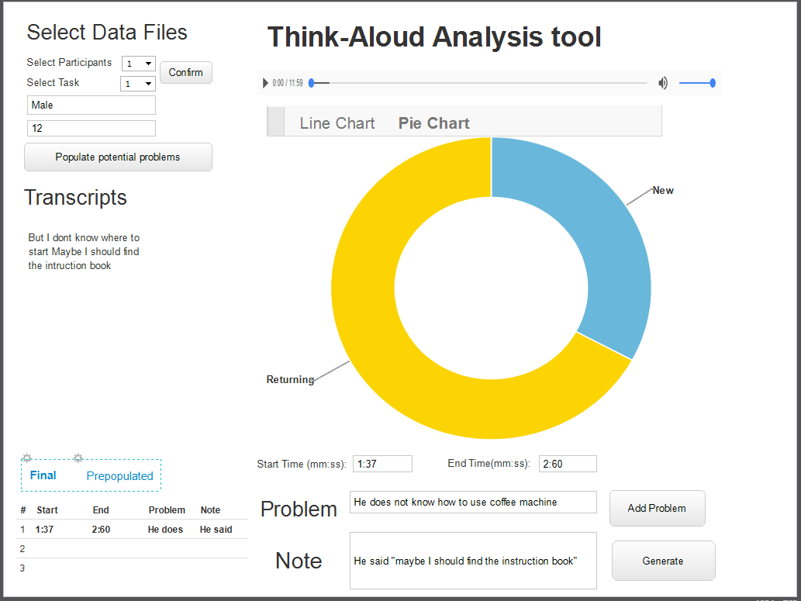
Here a pie chart version is introduced, it will be also scaled with time interval.We think a pie chart is easier for the user to navigate than a line chart after the identification of the problems.
After clicking on a certain section on the pie chart, the transcript will be a paragraph of sentence for that time interval for better readability.

Slide 10
Here for the populated interface. We want to apply colors to this line graph. For those certain interval if the algorithm thinks it’s safe from problems. They will be marked green. If it has a higher rate then it will be mark
orange or even red. It will deinitely offer a better readability for the users.

